Slide 1
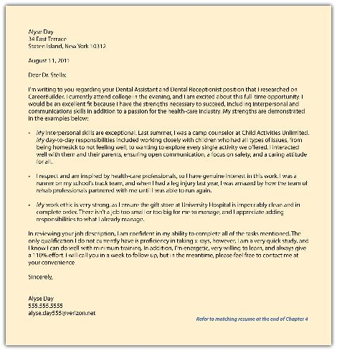

Preparing
My
Cover
Letter
MARK SAVAGE
msavag16@jhu.edu
Associate Director
Life Design Educator for Engineering Masters Students
Whiting School of Engineering
Johns Hopkins University
A Cover Letter Primer for
Technical Students

Slide 2
What is a COVER LETTER?
A formal letter that accompanies your resume
Expands on your experience to show you are a good match for the position.
A sample of your writing & communication skills – Must be clear & free of errors
Shows personality to give a sense if you are a good match for the company culture.

Slide 3


What is a COVER LETTER?
Unlike your resume, your Cover Letter is Individually Crafted for Each Application;
You probably don’t have time for that…
But the good news is…
A template can be developed and edited for each job you apply to, assuming similar jobs in similar industries.

Slide 4

Focus on what you have to offer and how you can help the employer.
NOT totally about why you want the position (although you DO need to convey that).
Revise it for each position you apply for. You want employers to feel you are writing it just for them.
Give specific reasons why you are interested in THIS position and THIS company/organization.

Slide 5
RESUME and COVER LETTER What is the difference?
THE RESUME:
Basically an OUTLINE
Answers the question: CAN you do the job?
Do you have: Right Skills, Education, Experience?
THE COVER LETTER:
Answers the question, DO YOU WANT to do THIS job at THIS organization?
Shows Interest, Motivation, Personality

Slide 6


Be Authentic—
Be Yourself !
Be Conversational: Approach as if you are telling a story –
Hiring Managers look for what’s NOT communicated in your resume

Slide 7

May use same header & font as in resume, but not required.
ONE PAGE
3 or 4 Paragraphs -- 10-12 Pt Font
SET MARGINS to balance letter on page
STANDARD business letter format for addresses, greeting and closing

Slide 8


KEEP IN MIND
Research the employer to explain your interest.
Employers want to see that you understand their business and their goals
Closely review the job description: Note key words, required skills and abilities
Address the letter to an actual person:
To Whom It May Concern, Dear Sir, Dear Madam

Slide 9


PARAGRAPH
COVER LETTER IS: 1st Impression of you!
Engage attention quickly & “hook” the reader
State the position you’re applying for … … and how you learned about it
State why you want to work for this company,
why this job, & related skills or experience you offer.
Mention anyone you know at the company or who
recommended you (this could instead go in last paragraph)

Slide 10


and/or PARAGRAPH
Use Examples…
From previous experiences to demonstrate
you can meet and exceed expectations.
Can Include: paid or unpaid work, internships,
research, course projects, leadership, volunteer work, etc.
Emphasize Accomplishments related to the position

Slide 11
and/or PARAGRAPH
Don’t just repeat what’s on your resume:
-- Connect the dots for the employer:
-- What you learned from an experience;
-- How it strengthened your skills in XXX.
Show why you’re a good “fit” for the job.

Slide 12

PARAGRAPH
Briefly Summarize…
How you might be uniquely qualified for the position.
Indicate a desire…. for an opportunity to further discuss how your skills & experience can meet the needs for this position.
Be enthusiastic and positive!
Thank the employer for their time and consideration.

Slide 13
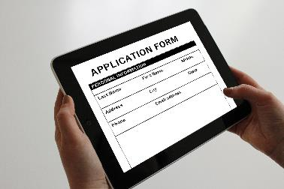
COVER EMAILS
When applying for a job by attaching a resume and cover letter in an email, the letter may not be read – so the email for your application should act as a short version of your cover letter.
Cover emails are short (5-6 sentences): you don’t want the reader to have to scroll.
Write to fit the tone of the company or organization.

Slide 14
COVER EMAILS
Include relevant links to personal websites, projects, blogs, etc. so the reader can quickly learn more about you.
Be specific: Focus on the most important aspects of your education, experience and skill set that qualify you for the job.

Slide 15
COVER EMAILS SUBJECT LINE:
Oftentimes, job ads note what to put in the subject line.
But if they don’t: Try something like….
“Application for Machine Learning position – Tom Lee”
Greeting: Try to find the name of who you are writing to on the company website – or try searching LinkedIn.
IF NOTHING WORKS:
Lead with “To the Director of Human Resources” or similar.

Slide 16
COVER EMAILS BODY:
Include info you want them to notice and remember about you.
Keep it Simple:
1. Who you are
2. Why you’re interested in this job & this organization
3. What you’ve done that’s relevant to the job
(Make the connections for them)
4. How you’re a great (or the best) candidate for this job
5. Where they can find out more about you.
Express enthusiasm and thank the reader for their time

Slide 17
COVER EMAILS CLOSING
Use your full name as the signature – Include links to any social media accounts
Don’t use emoticons Don’t use unusual fonts Don’t use a dumb-named email address

Slide 18




Mark Savage, Associate Director and Life Design Educator for Engineering Masters Students
Wyman Park Building – 3rd Floor West (Graduate Affairs Office)
msavag16@jhu.edu 410-516-2314
Johns Hopkins University
Homewood
Campus
This Photo by Unknown Author is licensed under CC BY-SA-NC

Slide 19
Mark Savage, Associate Director and Life Design Educator for Engineering Masters Students
Wyman Park Building – 3rd Floor West (Graduate Affairs Office)
msavag16@jhu.edu 410-516-2314
Johns Hopkins University
Homewood
Campus
This Photo by Unknown Author is licensed under CC BY-SA-NC

